Slide 1
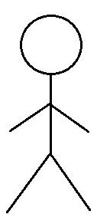
TROX: Physical Data Flow Diagram for User’s Account
01.03 Customer Support
user-information
credentials
user-data
01.01 Account Authentication/
Authorisation
02.01 browse/ search products
Product Details
Product
User
user-data
User Details
user-information
01.02 Account Summary
User Details
User

Slide 2
TROX: Logical Data Flow Diagram for User’s Account
01.03 Customer Support
user-information
01.01 Account Authentication/
Authorisation
user-data
02.01 browse/ search products
credentials
User
user-data
user-information
01.02 Account Summary

